Slide 1

An interactive AVL-Tree tutor
Construct an AVL tree by inserting the following elements in the order of their occurrence

Slide 2
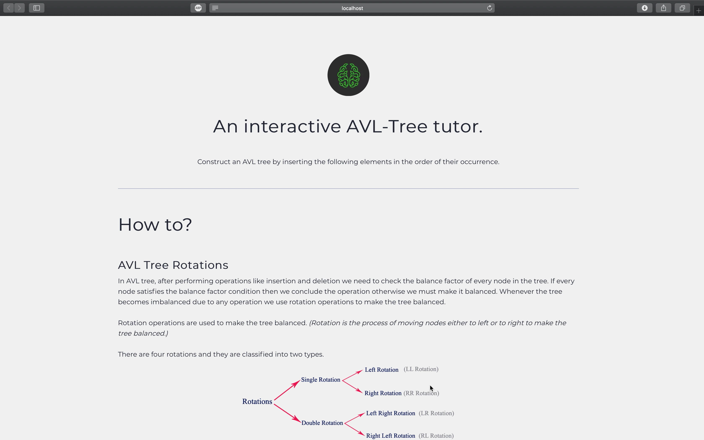

Slide 3
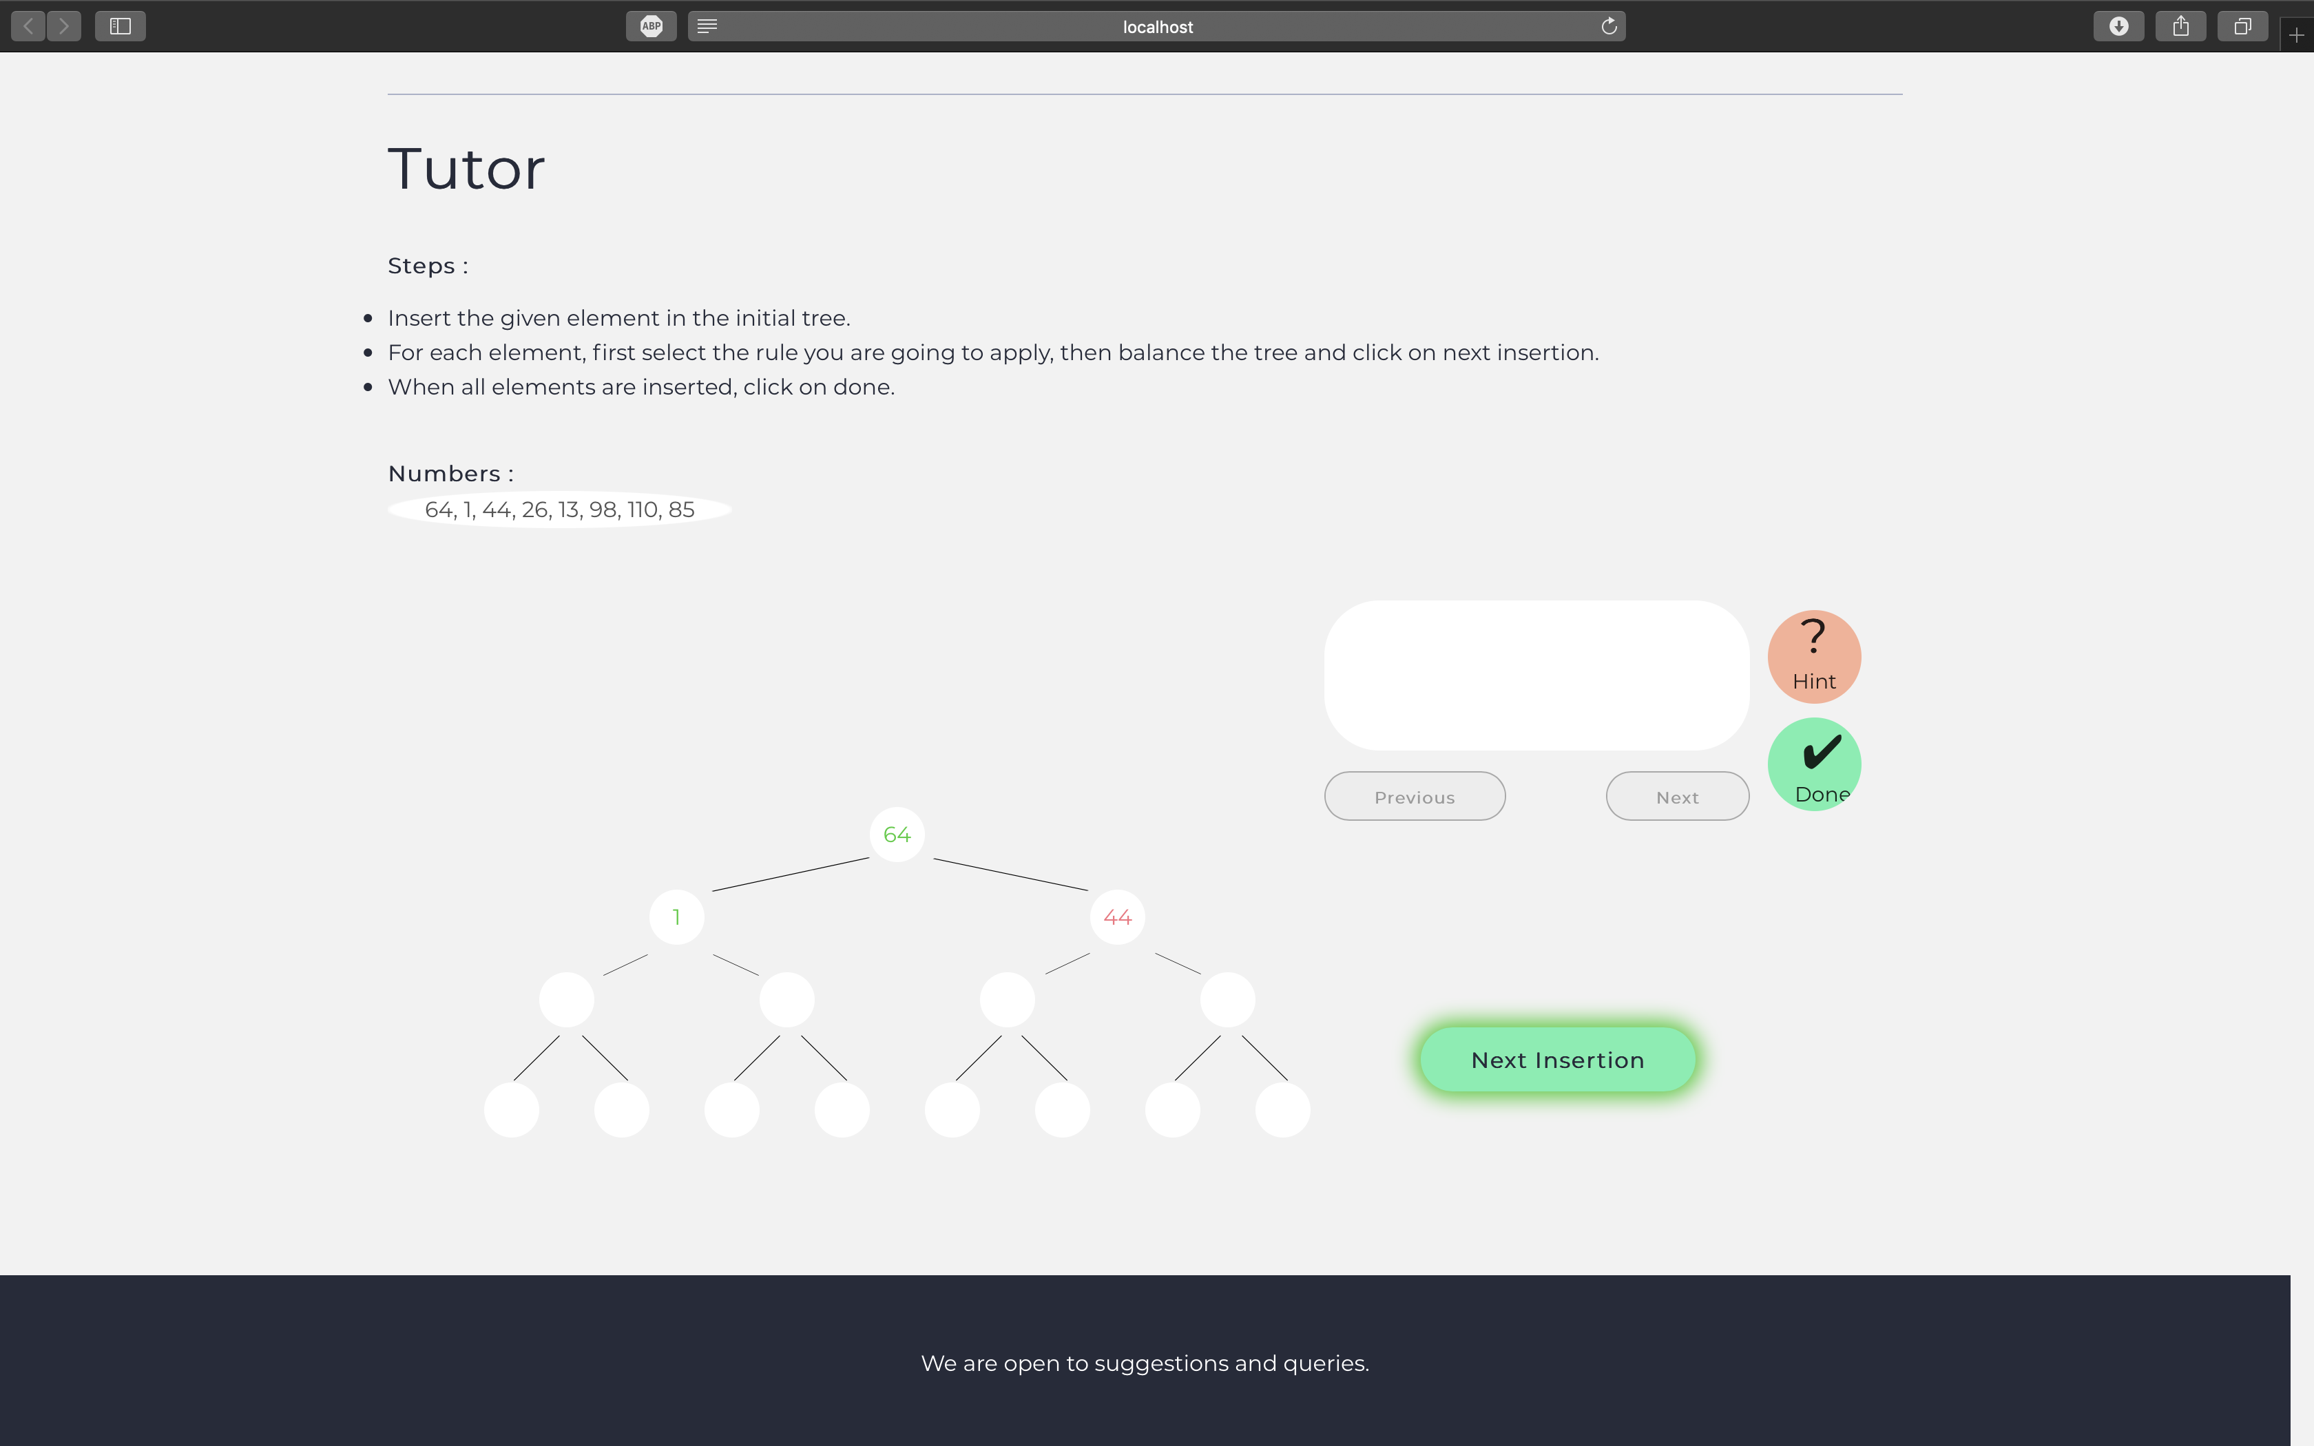
When the student makes a mistake that step is highlighted by red color and the tutor won't move to the next one until it's corrected

Slide 4
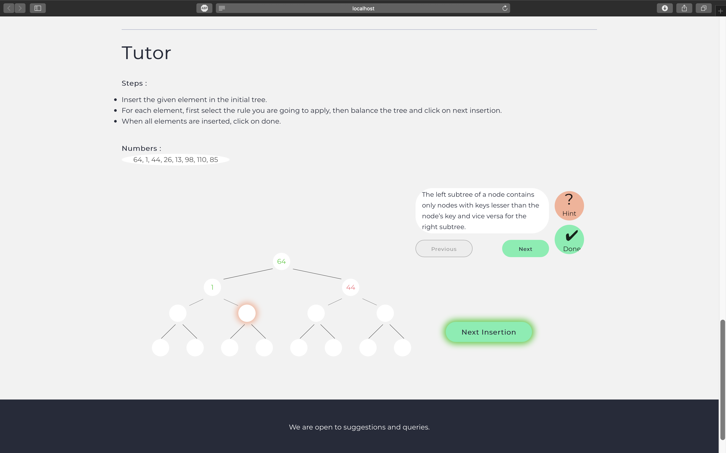
When a student requests a hint, the first hint from the relevant link is displayed. A link can have multiple levels, where each successive request by the student displays the next level of hint.

Slide 5
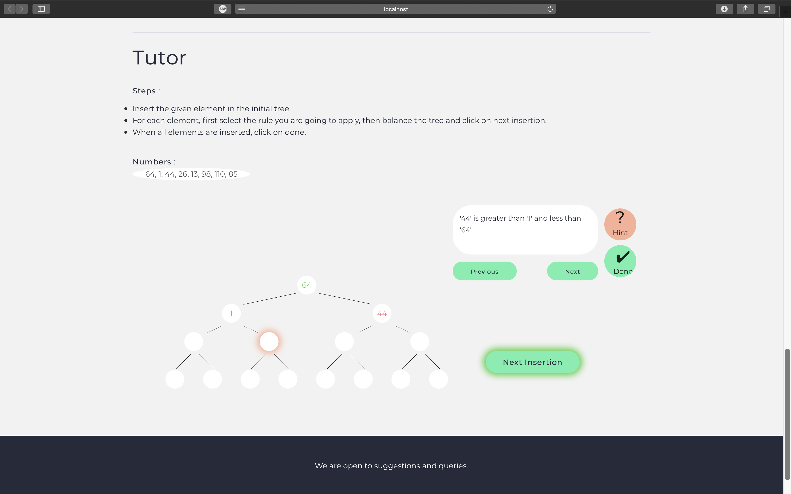
When a student requests a hint, the first hint from the relevant link is displayed. A link can have multiple levels, where each successive request by the student displays the next level of hint.

Slide 6
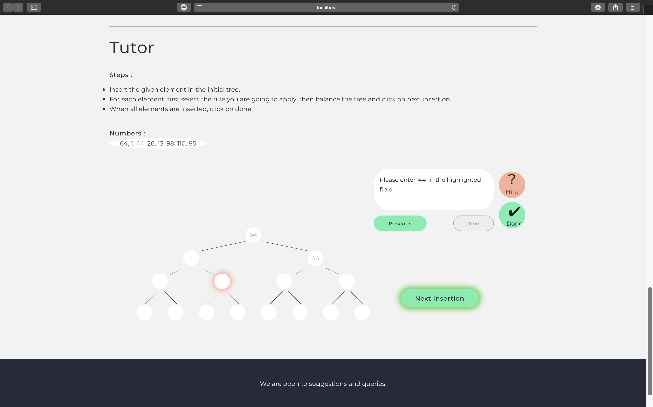
When a student requests a hint, the first hint from the relevant link is displayed. A link can have multiple levels, where each successive request by the student displays the next level of hint.

Slide 7
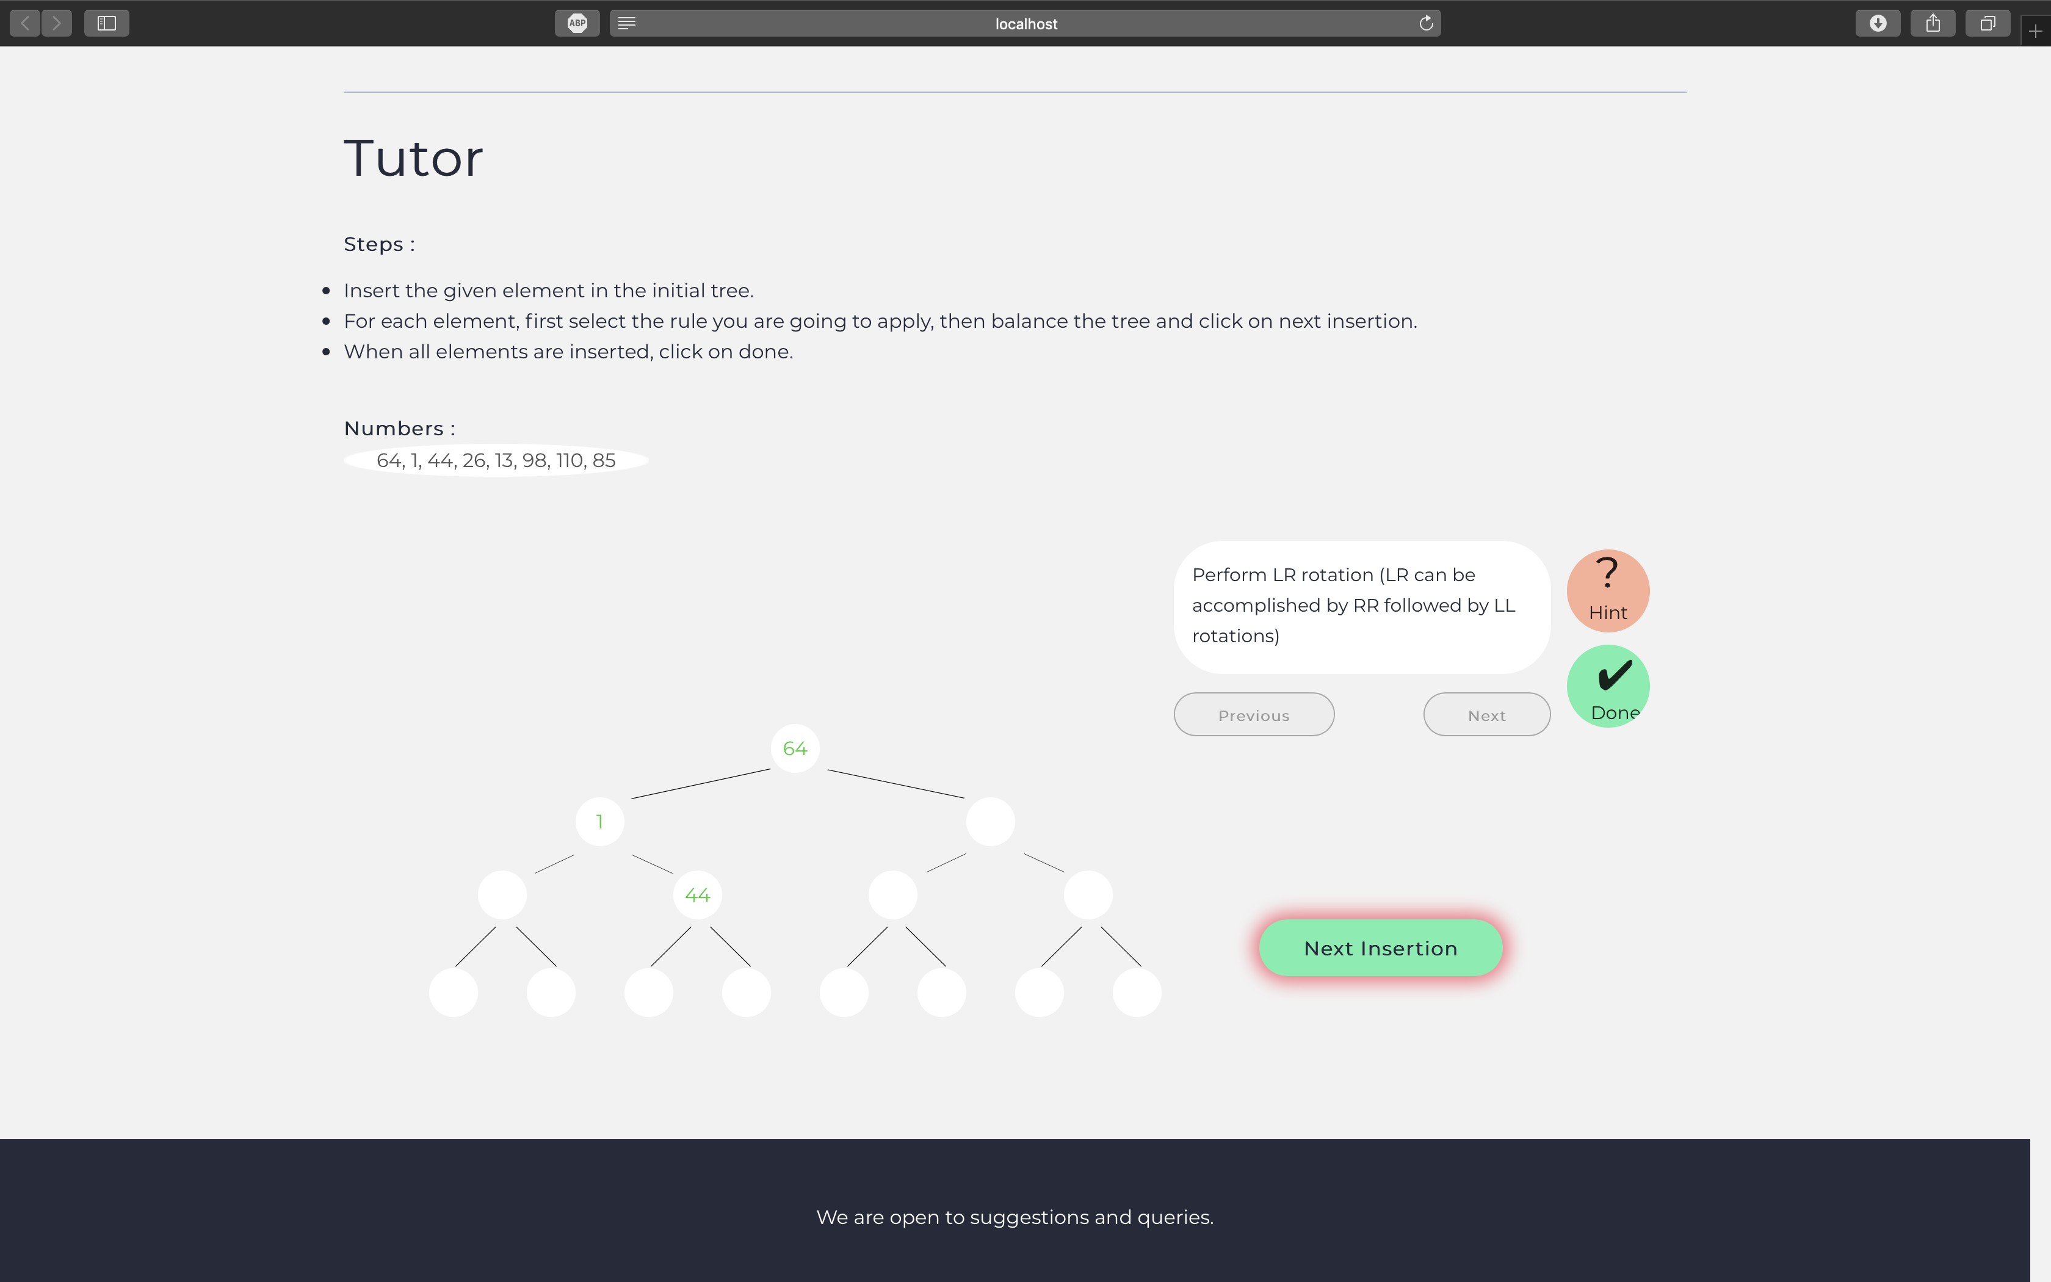
For correct action links, feedback is a success message. Similarly for an incorrect or suboptimal action, feedback is a buggy message.

Slide 8
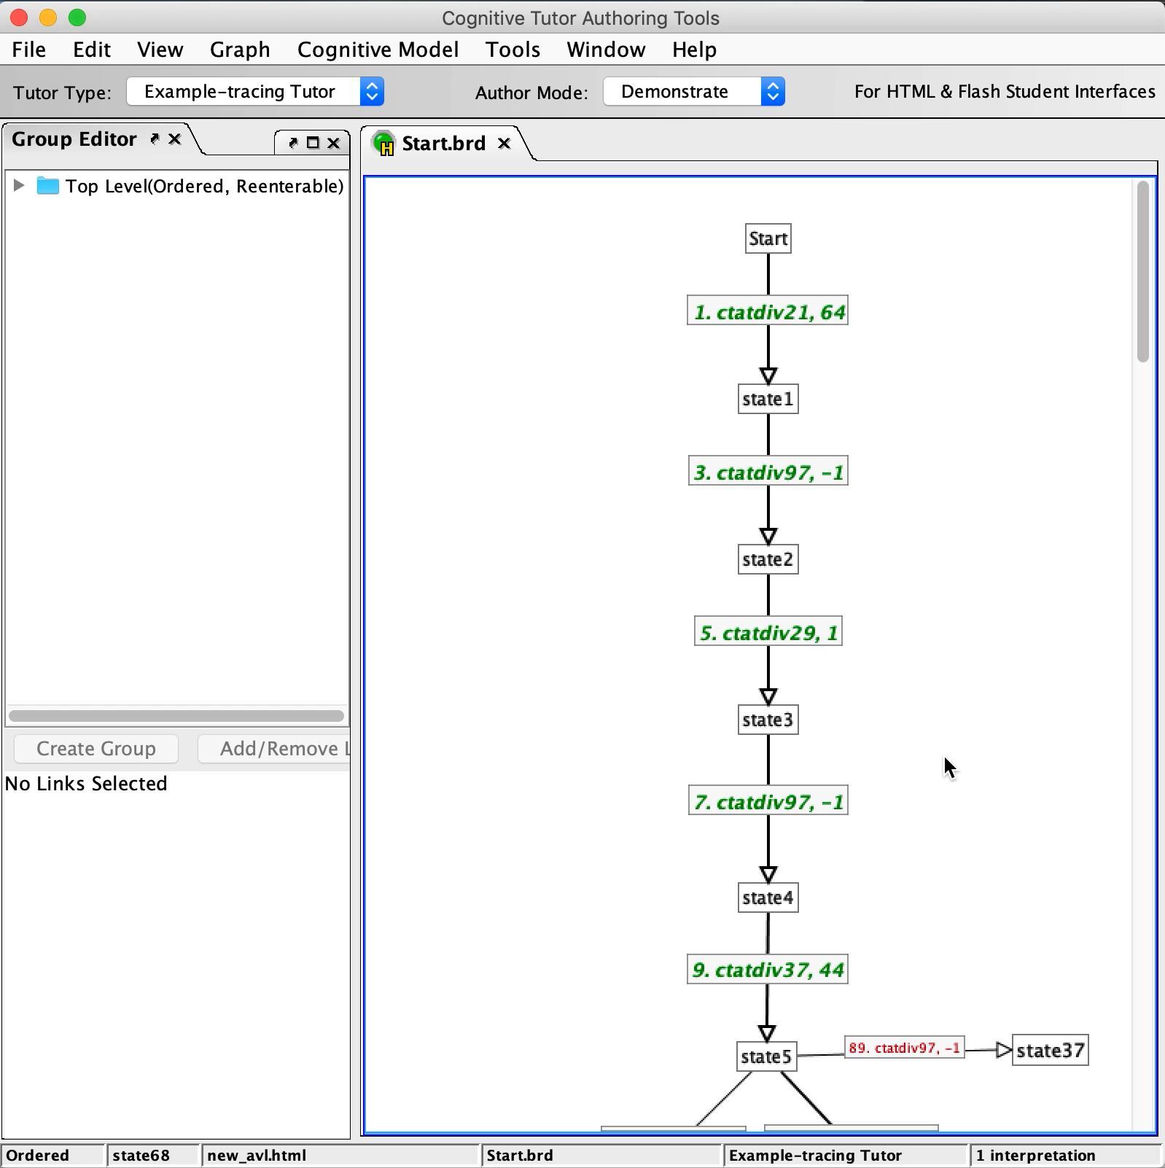
Using CTAT we made the behavior graph to describe different problems of AVL trees.
The BRD file also describes the steps students should take (or shouldn't take) as links in a node-link graph. Links in the graph represent actions that can be taken by the student or the tutor (in the case of a tutor-performed action). Nodes (or "states") in the graph represent stopping points between actions; except for the "start state" they store no information about problem-solving. In addition, the BRD file describes the graph properties that control behaviour such as whether or not to show hints and other feedback to the student.

Slide 9
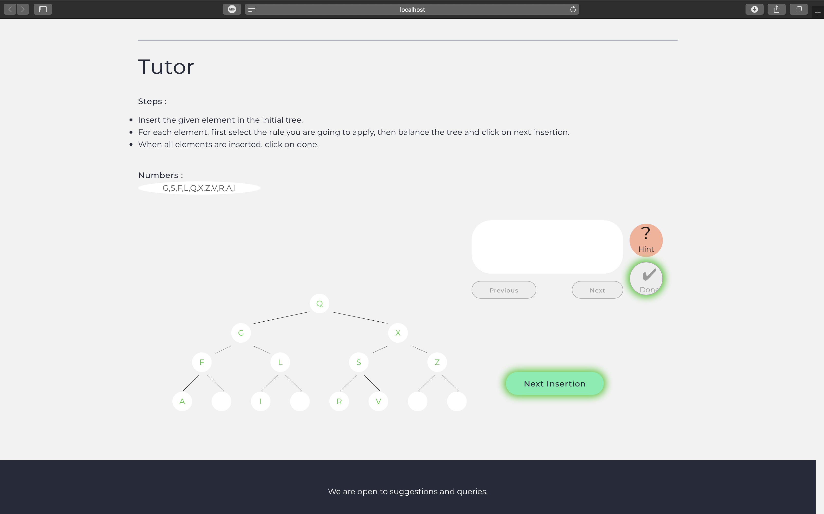
Just by changing the start state in the graph different types of problems can be generated for the user to practice upon.

